Slide 1




AN EVALUATION OF THE SCOTTISH PHARMACIST CLINICAL ACADEMIC FELLOWSHIP PROGRAMME: DEVELOPING RESEARCH TO ADVANCE PHARMACEUTICAL CARE PRACTICE ACROSS THE NHS
Dr Clare Depasquale, Susan Roberts, Dr Leon Zlotos, Prof Marion Bennie, Prof Andrew Sturrock, Prof Scott Cunningham

Slide 2
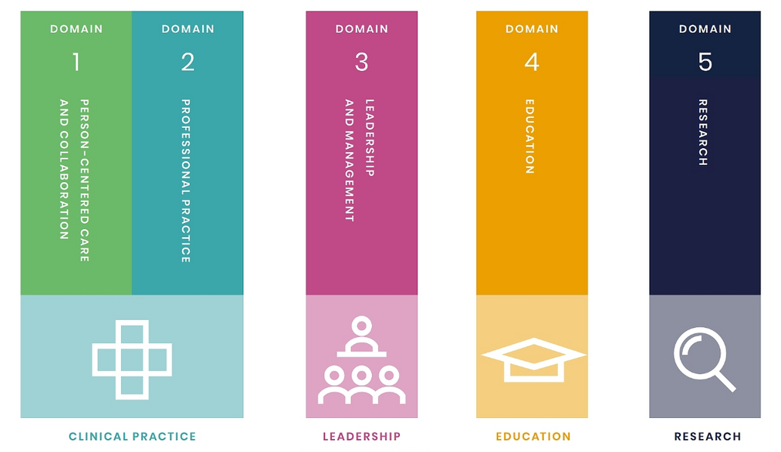

WHY?
The Royal Pharmaceutical Society’s credentialing curricula incorporate five broad domains that align to four ‘pillars of practice’. Research is one of these pillars [1].
Performance in this ‘pillar’ most frequently impedes credentialing success [2].
The Scottish Pharmacist Clinical Academic Fellowship (SPCAF) programme was created; a collaboration with Higher Education Institutions and NHS Education for Scotland; to develop a network of Clinical Academic Pharmacist posts.
2-year appointment
0.4 WTE
Royal Pharmaceutical Society. Credentialing. Defining and assuring post-registration standards of patient-focused pharmacy practice. [homepage on the internet]. London: RPS; 2025 [cited 2025 May 7]. Available from: https://www.rpharms.com/development/credentialing
Royal Pharmaceutical Society. RPS annual credentialing report 2022. [homepage on the internet]. London: RPS; 2022 [cited 2025 May 7]. Available from: https://www.rpharms.com/Portals/0/Credentialing/RPS%20Annual%20credentialing%20report%202022%20final.pdf?ver=spMTf5yMraBSMpAunhwXEw%3D%3D

Slide 3

AIM
To explore the views and experiences of key stakeholders involved in the SPCAF programme cohort 1 (2021-2023).

Slide 4

HOW?
Online semi-structured interviews were conducted between December 2024 - January 2025 with:
5 SPCAF programme Fellows
5 other stakeholders (Fellows’ line managers, local/academic mentors, wider pharmacy team members).
Study was theory informed
The Theoretical Domains Framework (TDF) [3].
Thematic analysis was applied to transcripts.
3. Atkins L, Francis J, Islam R, O’Connor D, Patey A, Ivers N et al. A guide to using the Theoretical Domains Framework of behaviour change to investigate implementation problems, Implement Sci, 2017; 12(77).

Slide 5
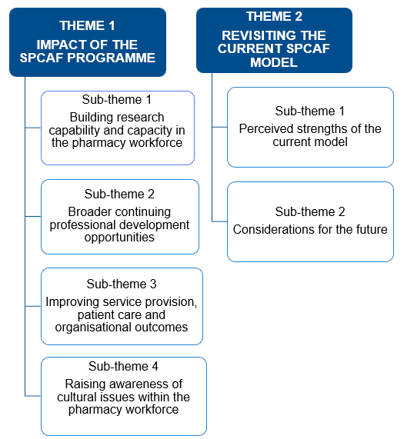


WHAT?
… it will not only affect and help the students who are doing the research, but what they learn will knock on to other people. For example, my student has been asked to input into somebody else's data analysis based on the skills that she's learnt, so it's already having knock on effects to other people.
(OS 3)
… it's really valuable for those people who are interested in doing bigger research, who have an idea, but don't know where to start. Because having that kind of NHS and academic support has been invaluable.
(CAF 4)
I think you really will have to have a wee bit of thought about earlier career stages and how you assess somebody’s readiness for this Fellowship. And or when you bring them into it … how you check their fundamentals right in the first month or two? So that we really understand where they're starting ... But the base-level was much lower than we expected with some of these Fellows.
(OS 1)

Slide 6
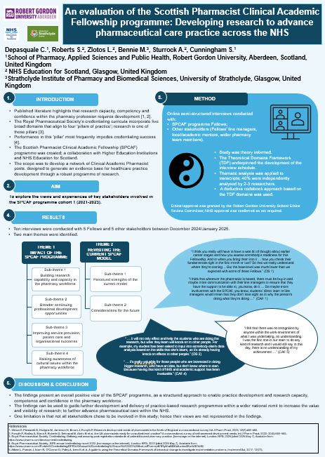

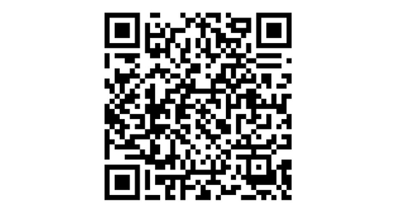
THANK YOU!
Clare Depasquale
c.depasquale@rgu.ac.uk

